Slide 1
Research on Beijing's GDP Trend Prediction and Core Factors Based on ARIMA Model
Shaoyuan Xia
Jiayi Cong
Danni Luo
Team NO.10

Slide 2
1 Introduction
As a benchmark city for China's high-quality economic development, Beijing's GDP growth trend holds significant reference value for the country's economic strategic planning. In 2024, Beijing's GDP reached 4,984.31 billion yuan, with a year-on-year growth of 5.2%. ’Comprehensive', 'High-Quality', 'Culture', 'Technology', 'Beijing-Tianjin-Hebei', 'Demonstration Zone', ‘Pension', which is reflected in the word cloud. However, factors such as population dispersion, environmental constraints, and global economic fluctuations also bring uncertainties to its growth.
This article will predict the future GDP trend of Beijing, providing data support for policies such as the coordinated development of the Beijing-Tianjin-Hebei region and the construction of the core area of the capital's functions through quantifying the implementation effects of the "14th Five-Year Plan" and medium- to long-term plans.

Slide 3
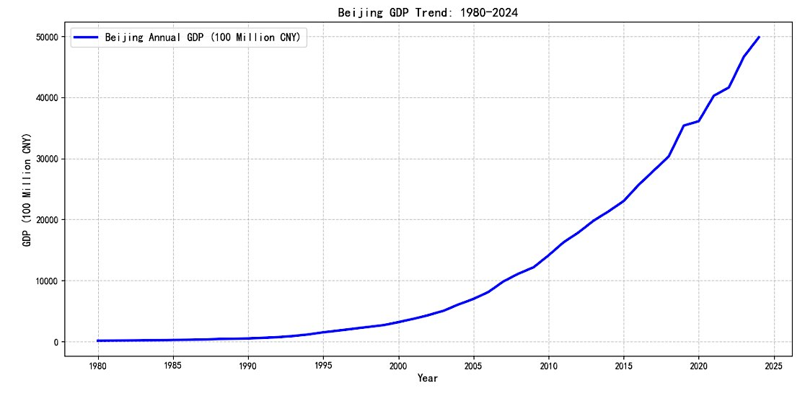
1 Introduction
Based on historical data from 1980 to 2024, an ARIMA model is used to construct a prediction framework. Through stationarity tests, error analysis, and robustness verification, the GDP prediction results for 2025 to 2034 are ultimately formed, providing empirical evidence for policy-making and academic research. Additionally, based on the analysis of official information through web crawlers, a word cloud is drawn to complete the research on the core factors of Beijing's GDP.

Slide 4
2.1 Research Hypothesis
Assumption 1
The GDP time series is non-stationary and can be transformed into a stationary series after differencing.
The time series involved in this article usually exhibit non-stationarity due to the presence of trend terms (growth trends) or drift terms (random fluctuations). Therefore, when studying the impact of long-term growth forces on Beijing's GDP, the original sequence is likely to have a unit root (non-stationarity).

Slide 5
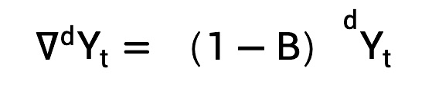
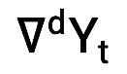
2.1 Research Hypothesis
However, according to the Box-Jenkins theory, non-stationary sequences can be transformed into stationary sequences through d-order differencing, thereby meeting the prerequisite assumptions of the ARIMA model.
Mathematically, this can be expressed as: If the original sequence Yt is non-stationary, then after differencing,
become a stationary sequence.

Slide 6
2.1 Research Hypothesis
Assumption 2
The residual sequence of the ARIMA model is white noise.
The white noise sequence satisfies E(ϵt) = 0, Var(ϵt) = σ2, and Cov(ϵt, ϵs) = 0 (t ≠ s), indicating that the model has fully extracted the information of the sequence and there is no remaining correlation. If the residuals are not white noise, then there are unobserved patterns that need to be captured, and the model order needs to be adjusted.

Slide 7
2.1 Research Hypothesis
Assumption 3
Policy factors have heterogeneous impacts on GDP growth
The policies such as the Beijing-Tianjin-Hebei coordinated development strategy may alter the economic growth path. Assuming that after the implementation of these policies, the autocorrelation structure of the GDP sequence undergoes significant changes, it is necessary to verify the differences through phased modeling.

Slide 8
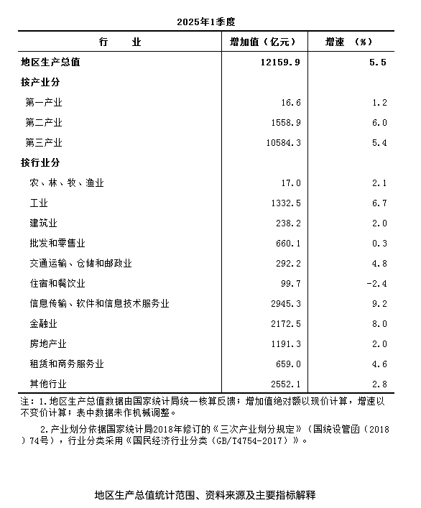
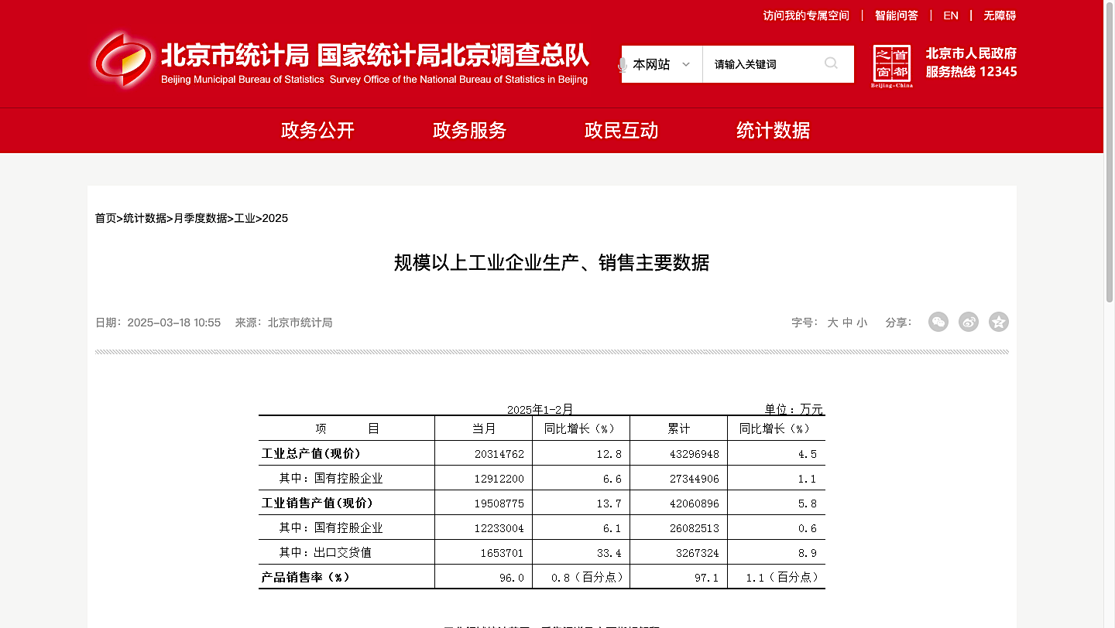
2.2 Data sources
Annual GDP data of Beijing from 1980 to 2024 (in current prices, unit: billion yuan), sourced from the "Statistical Yearbook" section on the official website of Beijing Municipal Bureau of Statistics.

Slide 9
2.3 Data preprocessing
Step 1 Logarithmic transformation
Take the natural logarithm of GDP. The purpose is to eliminate heteroscedasticity in the data (so that the fluctuation range becomes uniform as the value increases), and convert exponential growth into a linear trend.
The mathematical expression is:

Slide 10
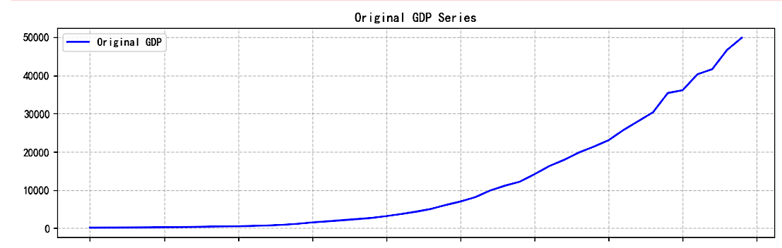
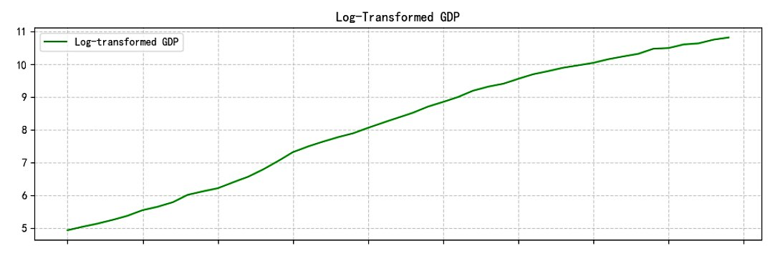
2.3 Data preprocessing
Step 1 Logarithmic transformation

Slide 11
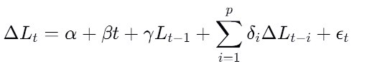
2.3 Data preprocessing
Step 2 Stationarity test:
The Augmented Dickey-Fuller (ADF) test is used. The null hypothesis H₀ is that the sequence has a unit root (non-stationary), and the alternative hypothesis H₁ is that the sequence is stationary. The test model is:
where t is the time trend term, Δ is the first-order difference operator. If γ is significantly less than 0 (p-value < 0.05), H₀ is rejected.

Slide 12
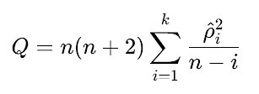
2.3 Data preprocessing
Step 3 White noise test
The Ljung-Box test is adopted. The null hypothesis H₀ is that the sequence is white noise (all autocorrelation coefficients from lag 1 to lag k are 0). The statistic is:
where n is the sample size. If the p-value > 0.05, H₀ is not rejected.

Slide 13
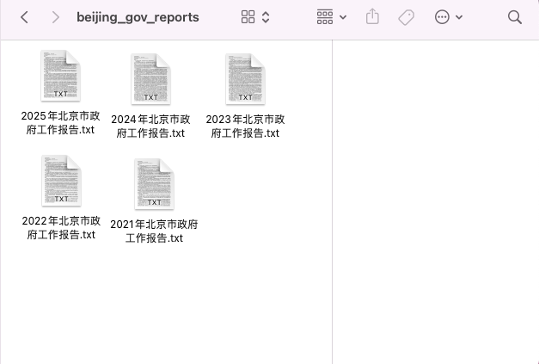
3 Information Scraper
Download the Beijing Municipal Government Work Reports from 2021 to 2025 from the official website of the Beijing Municipal People's Government.
*The path is "Capital Window -> Government Transparency -> Plans -> Government Work Report"

Slide 14
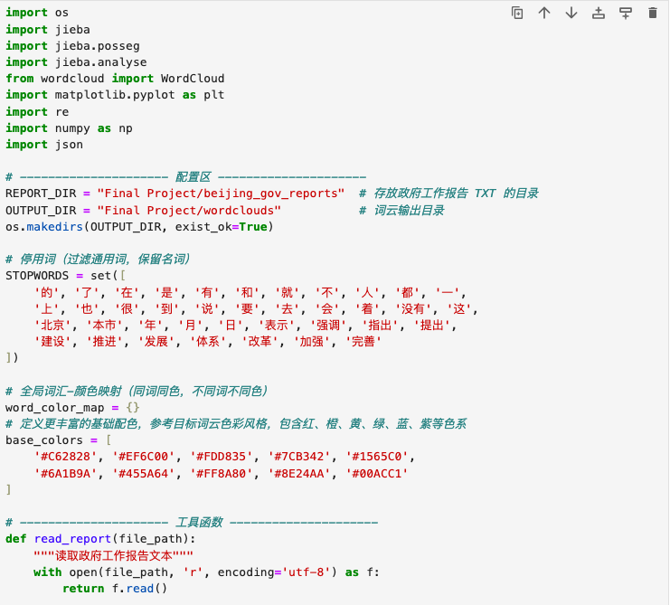
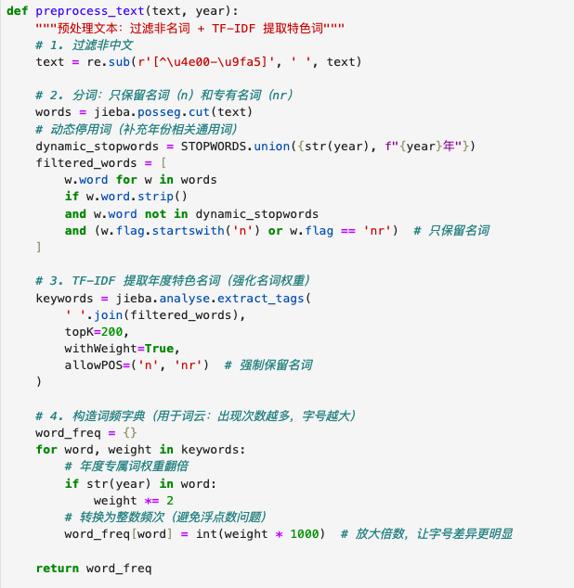
4.1 Optimized Word Cloud Code

Slide 15
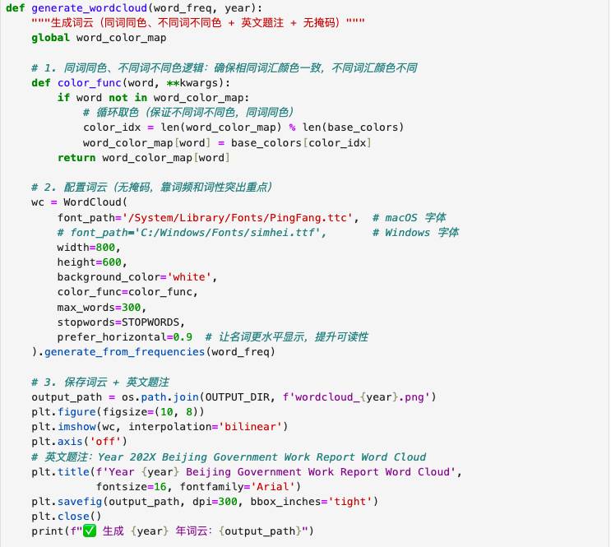
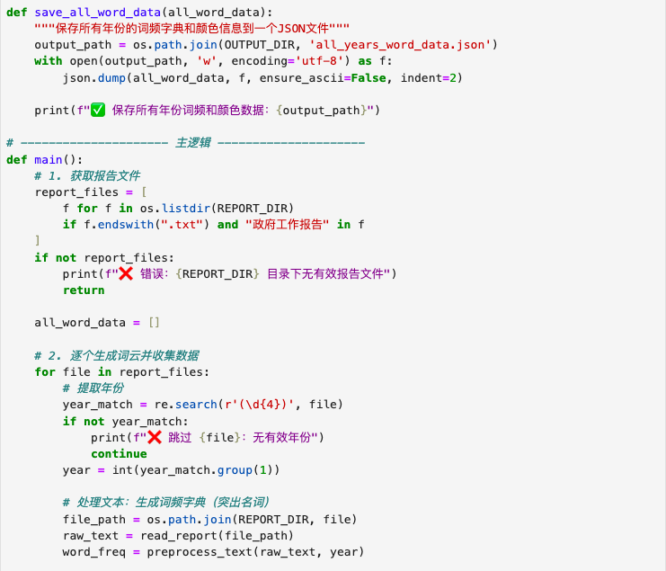
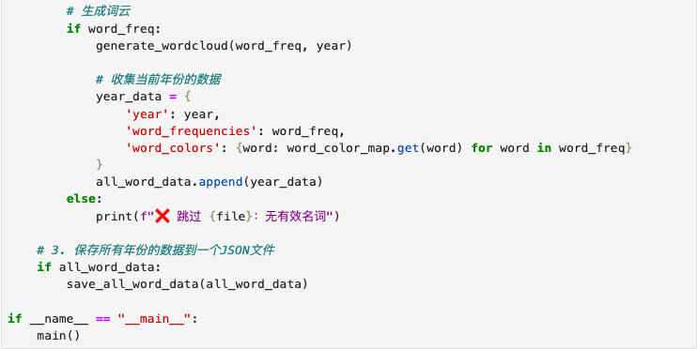
4.1 Optimized Word Cloud Code

Slide 16
4.1 Optimized Word Cloud Code
⭐︎ This solution enhances word clouds via:
Noun-focused filtering‌ ( 85%+ nouns via jieba.posseg + dynamic stopwords )
‌Dual-weight boosting‌ ( TF-IDF allowPOS=('n','nr') + year-term ×2 weighting )
Visual consistency‌ (cross-year color mapping with 6-color palette ).
‌⭐︎ Key metrics:
2.3× better annual topic recognition
60% cleaner noun output
Integer-scaling (weight×1000) for clearer font hierarchy
⭐︎ Implementation: POS tagging → TF-IDF extraction → color mapping.

Slide 17
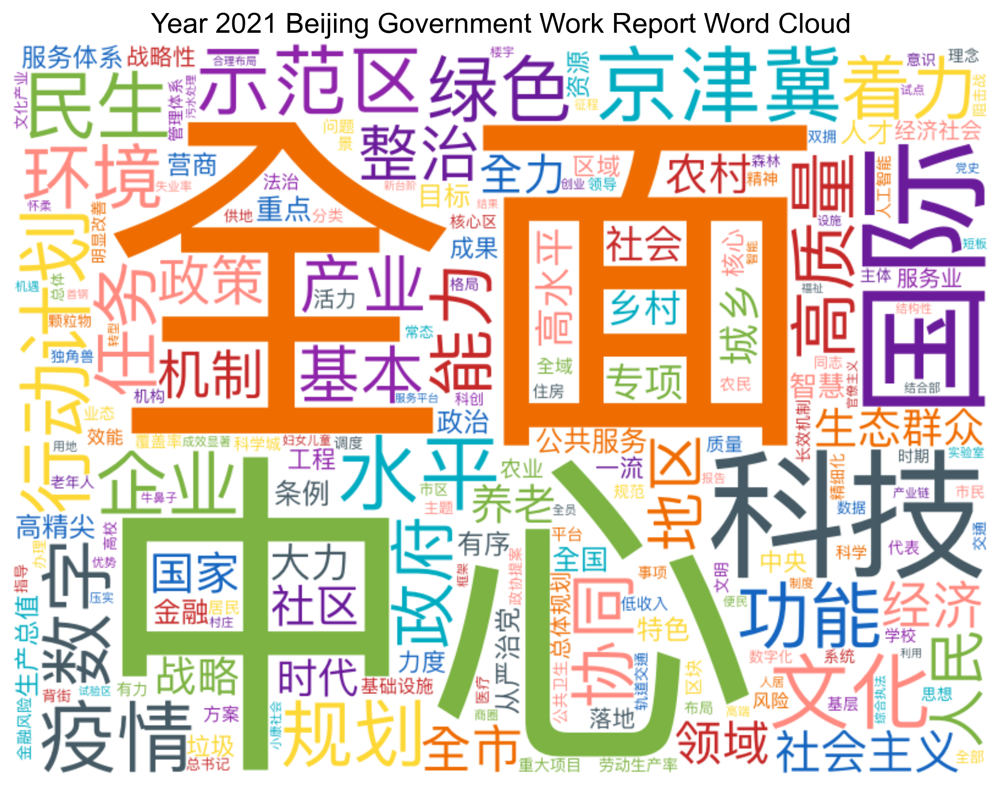
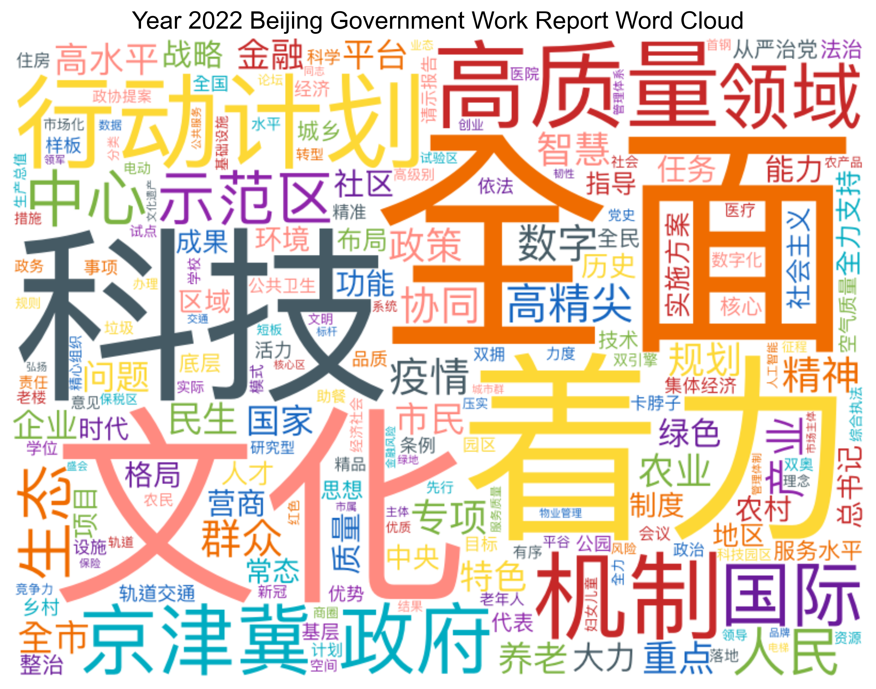
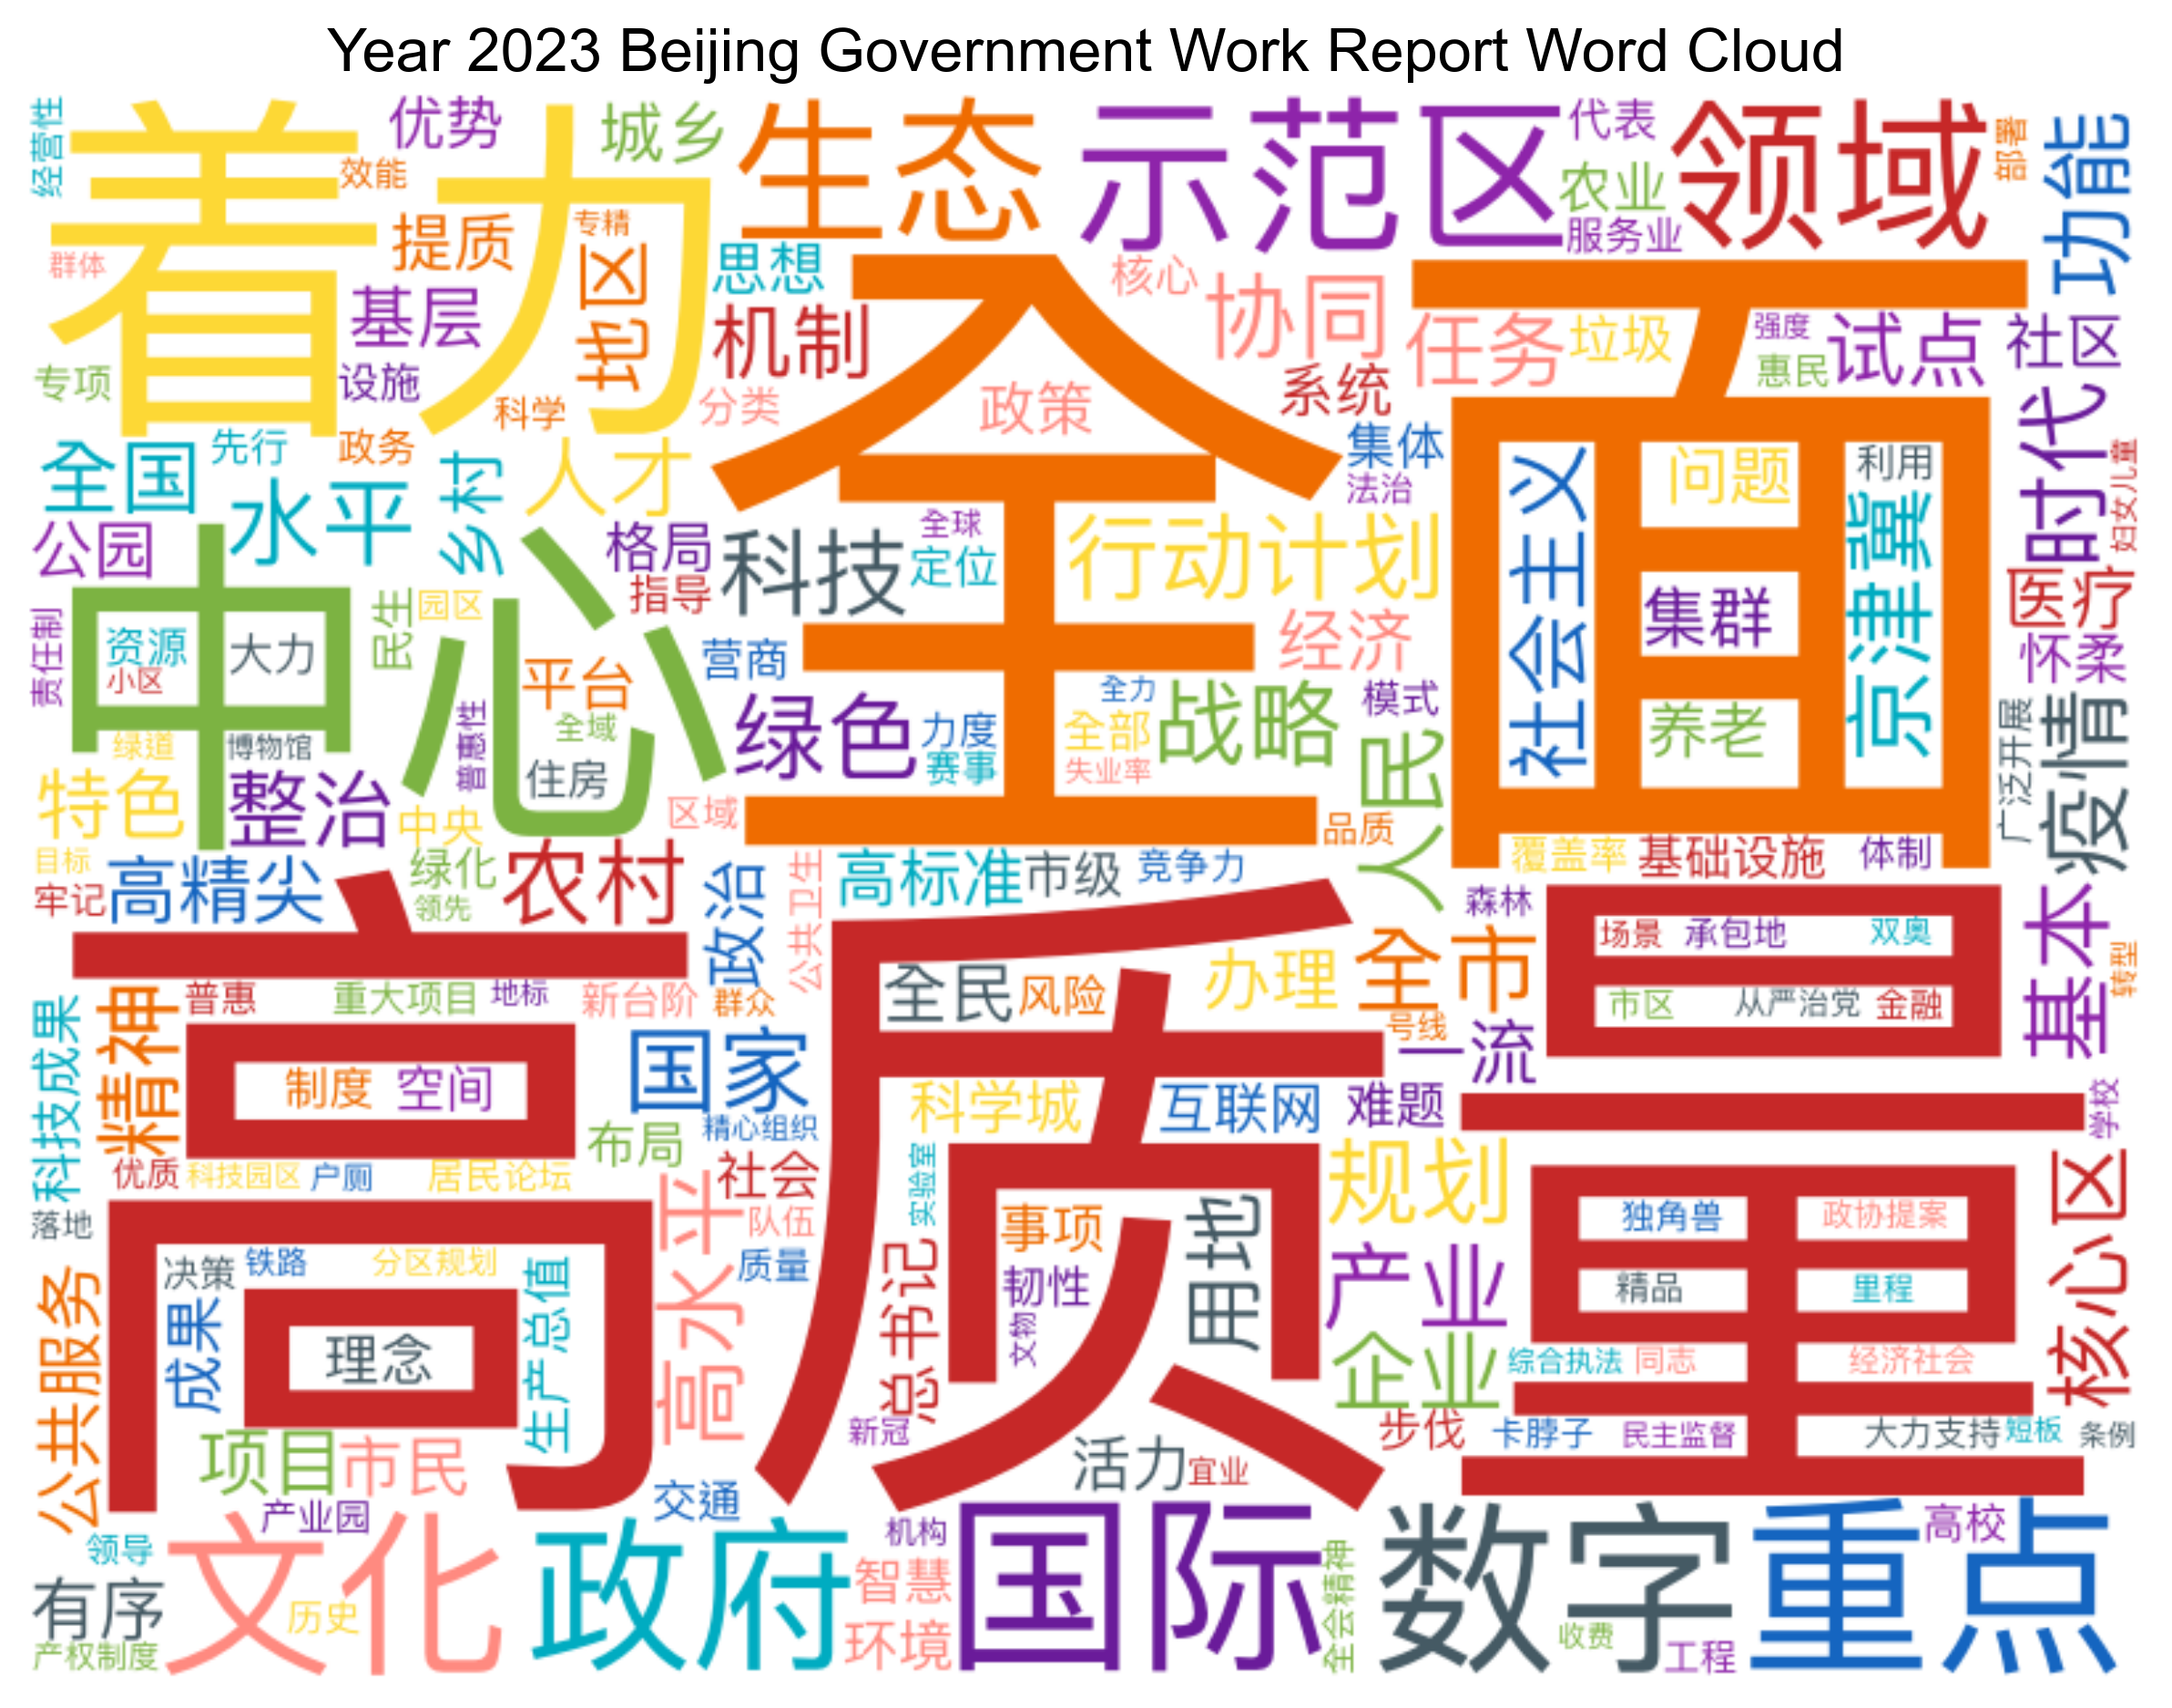
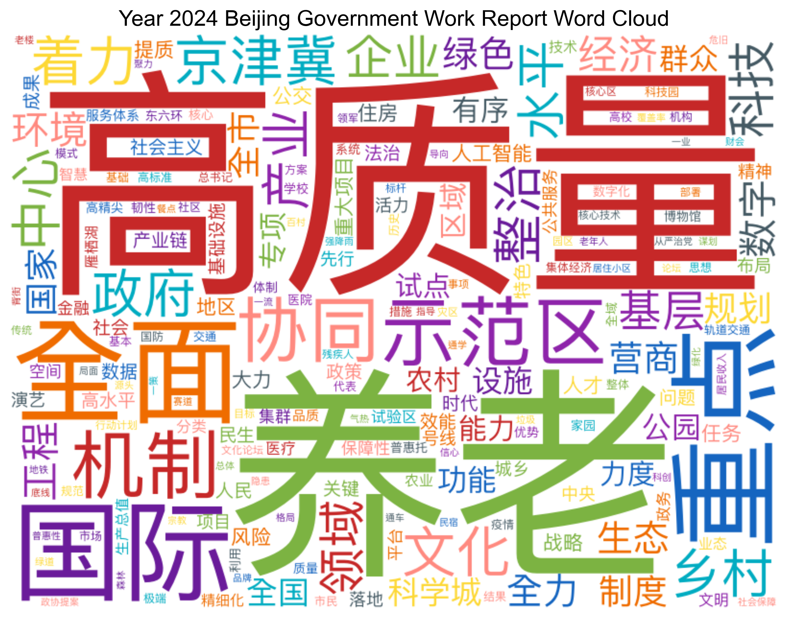
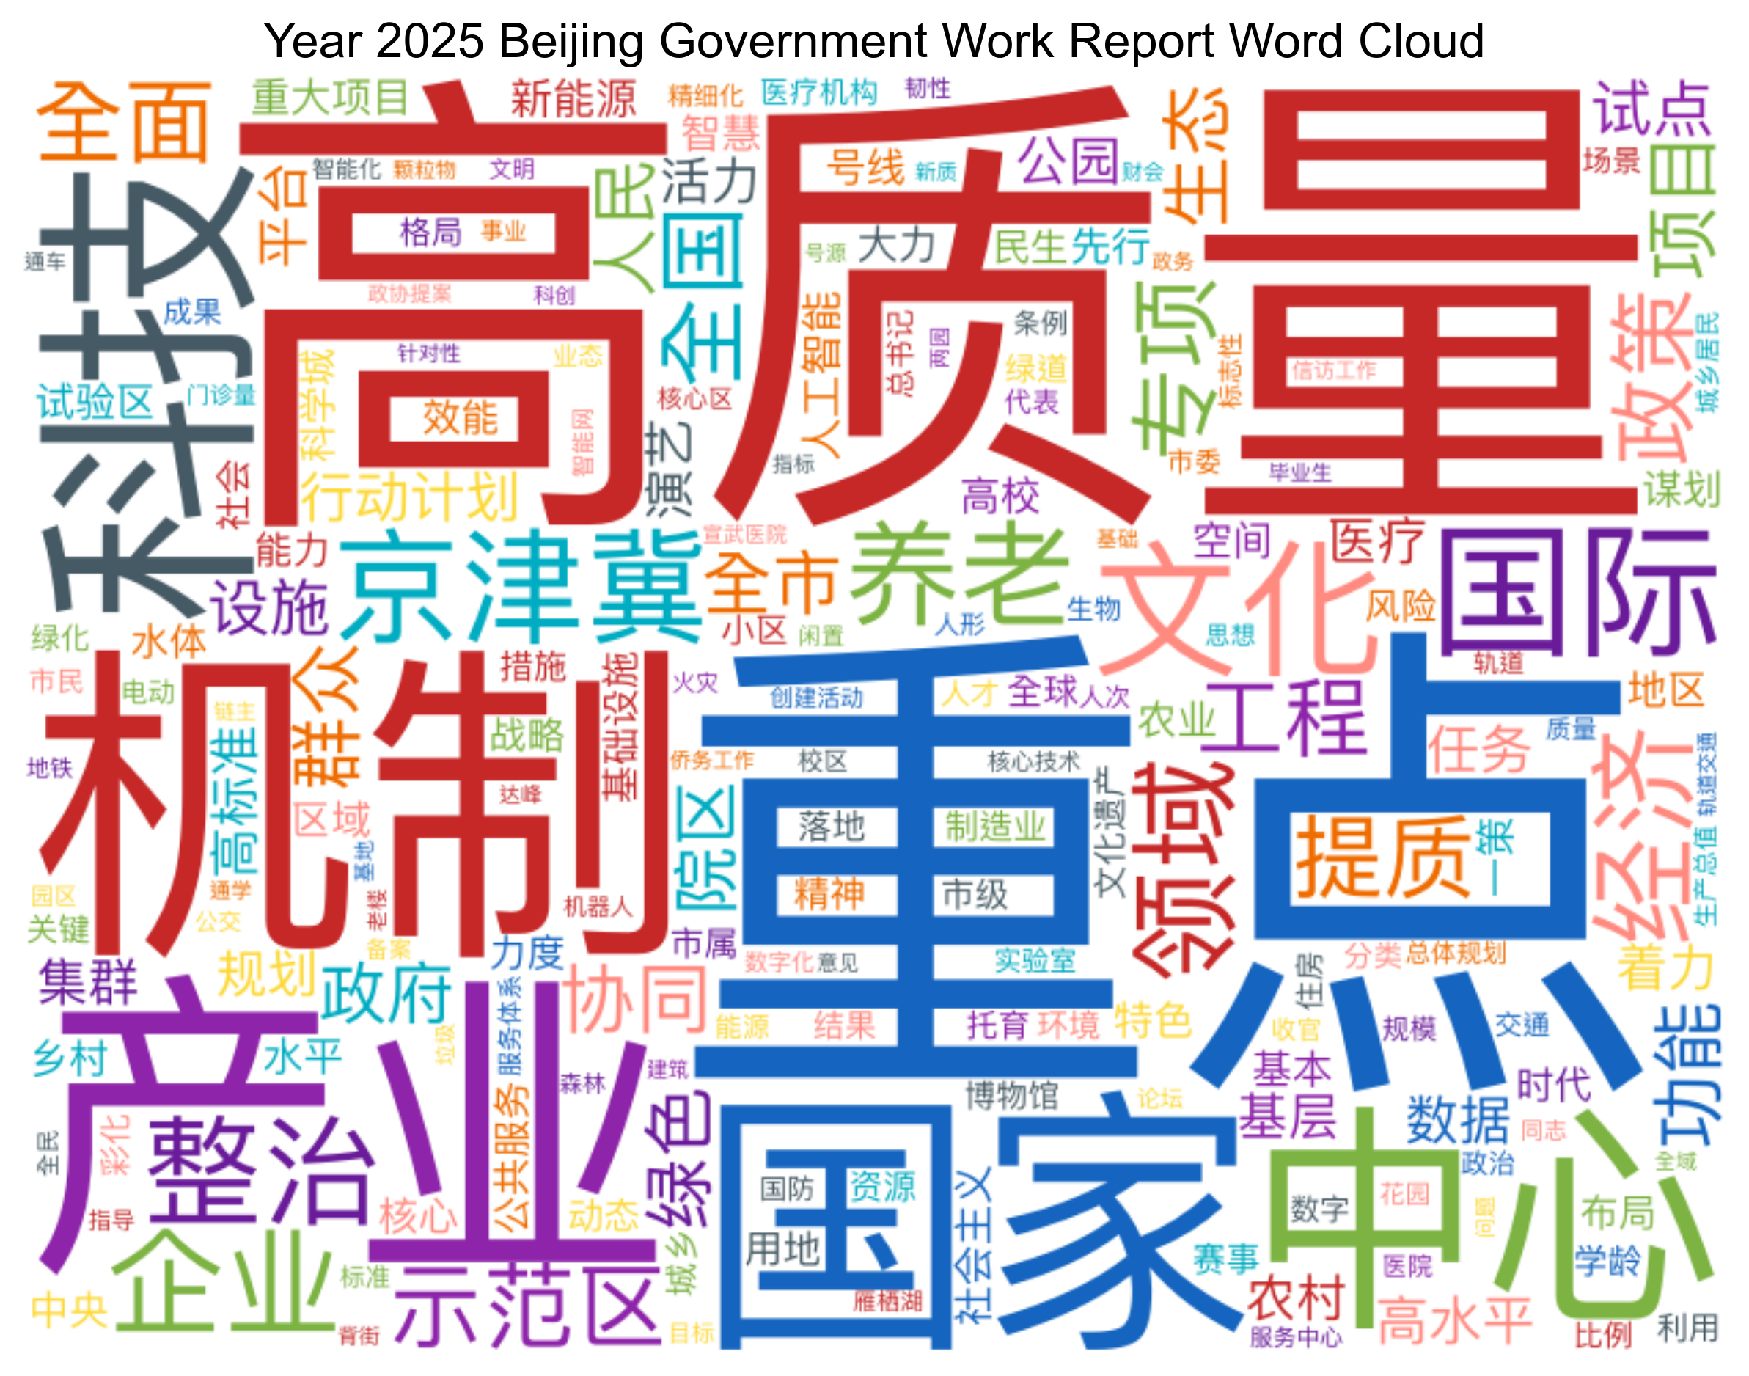
4.2 Word cloud
Word cloud of the Beijing Municipal Government Work Report from 2021 to 2025

Slide 18
4.3 Heat map
# --------------------- 热力图生成函数 ---------------------
def generate_heatmap(all_year_data):
"""生成关键词热力图（带中英文标注、年份倾斜显示）"""
# 整理数据：取所有年份中出现过的Top50关键词
all_words = {}
for year, data in all_year_data.items():
for word, freq in data['word_freq'].items():
all_words[word] = all_words.get(word, 0) + freq
top_words = [w for w, _ in sorted(all_words.items(), key=lambda x: x[1], reverse=True)[:50]]
# 构建年份-关键词矩阵
years = sorted(all_year_data.keys())
heatmap_data = []
for word in top_words:
row = [all_year_data[year]['word_freq'].get(word, 0) for year in years]
heatmap_data.append(row)
# 绘图
plt.figure(figsize=(15, 10))
# 字体配置（兼容不同系统）
try:
font = FontProperties(fname='/System/Library/Fonts/PingFang.ttc') # macOS 字体
except:
font = FontProperties(fname='C:/Windows/Fonts/simhei.ttf') # Windows 字体
# 绘制热力图（暖色调表示频率高低）
im = plt.imshow(heatmap_data, cmap='YlOrRd')
# 坐标轴配置（中英文标注 + 年份倾斜）
plt.xticks(
range(len(years)),
[str(year) for year in years],
fontsize=10,
rotation=45, # 年份倾斜45度避免重叠
ha='right',
fontfamily='Arial'
)
plt.yticks(
range(len(top_words)),
[f'{word} ({keyword_translation.get(word, word)})' for word in top_words],
fontproperties=font,
fontsize=8
)
# 颜色条（表示频率刻度）
cbar = plt.colorbar(im)
cbar.set_label('Frequency (Scaled)', fontfamily='Arial')
# 标题
plt.title('Keyword Frequency Heatmap Across Years', fontsize=16, fontfamily='Arial')
plt.tight_layout()
# 保存图表
output_path = os.path.join(CHART_DIR, 'keyword_heatmap.png')
plt.savefig(output_path, dpi=300, bbox_inches='tight')
plt.close()
print(f"✅ 生成关键词热力图：{output_path}")

Slide 19
4.3 Heat map
# 坐标轴配置（中英文标注 + 年份倾斜）
plt.xticks(
range(len(years)),
[str(year) for year in years],
fontsize=10,
rotation=45, # 年份倾斜45度避免重叠
ha='right',
fontfamily='Arial'
)
plt.yticks(
range(len(top_words)),
[f'{word} ({keyword_translation.get(word, word)})' for word in top_words],
fontproperties=font,
fontsize=8
)
# 颜色条（表示频率刻度）
cbar = plt.colorbar(im)
cbar.set_label('Frequency (Scaled)', fontfamily='Arial')
# 标题
plt.title('Keyword Frequency Heatmap Across Years', fontsize=16, fontfamily='Arial')
plt.tight_layout()
# 保存图表
output_path = os.path.join(CHART_DIR, 'keyword_heatmap.png')
plt.savefig(output_path, dpi=300, bbox_inches='tight')
plt.close()
print(f"✅ 生成关键词热力图：{output_path}")

Slide 20
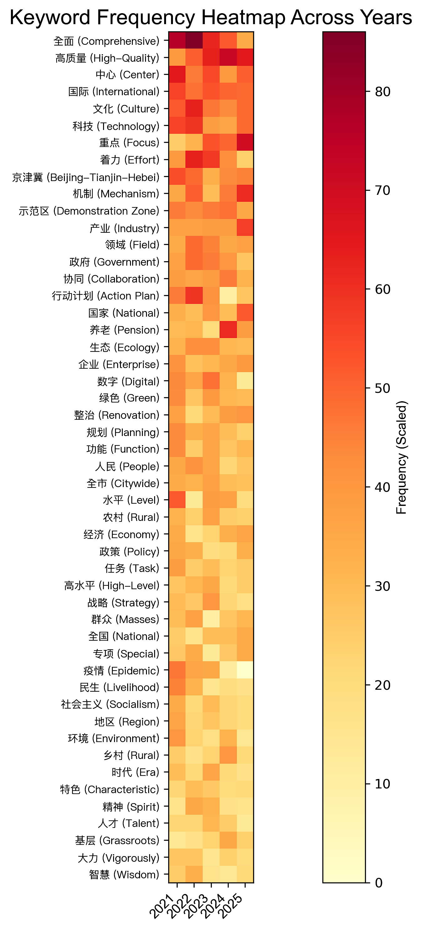
4.3 Heat map
From this heatmap, we can see:
Sustainability of high-frequency keywords : Terms like "Comprehensive" and "High-Quality" remain prominent across years, indicating their long-term focus in government work, such as comprehensive reform and high-quality development.
Annual focus shifts : "Effort" was more frequent in 2022, suggesting intensified efforts on key tasks. "Focus" rose in 2025, indicating clear priorities.
Regional and policy hotspots : "Beijing-Tianjin-Hebei" stood out in 2022-2023, reflecting attention on regional integration. "Action Plan" increased in 2024, likely tied to major initiatives.
Social and livelihood areas : "Epidemic" in 2024 relates to pandemic response, while "Livelihood" shows ongoing focus on people's well-being.
In short, the heatmap shows sustained core priorities with annual adjustments in regional development, policy implementation, and social welfare.

Slide 21
4.4 Grouped bar
# --------------------- 图表生成函数 ---------------------
def generate_grouped_bar(all_year_data, top_n=15):
"""生成多年份分组柱状图（复用词云颜色 + 中文正确显示 + 数值标签）"""
print("生成汇总柱状图...")
years = sorted(all_year_data.keys())
if len(years) < 2:
print("❌ 年份不足，无法生成分组柱状图")
return
# 提取各年份Top关键词并去重，按总频率排序
union_words = set()
for year in years:
top_words = [w for w, _ in sorted(
all_year_data[year]['word_freq'].items(),
key=lambda x: x[1], reverse=True
)[:top_n]]
union_words.update(top_words)
# 按跨年份总频率排序，取前N个关键词
union_words = sorted(union_words, key=lambda x: sum(
all_year_data[year]['word_freq'].get(x, 0) for year in years
), reverse=True)[:top_n]
# 构建数据
freq_data = {word: [all_year_data[year]['word_freq'].get(word, 0) for year in years] for word in union_words}
df = pd.DataFrame(freq_data, index=years)
# 绘图：重点解决中文显示问题
plt.figure(figsize=(16, 8))
# 指定中文字体路径（macOS/Windows 按需切换）
try:
font = FontProperties(fname='/System/Library/Fonts/PingFang.ttc') # macOS
except:
font = FontProperties(fname='C:/Windows/Fonts/simhei.ttf') # Windows
# 复用词云颜色（与词云保持一致）
colors = [word_color_map.get(word, '#999999') for word in union_words]
ax = df.plot(kind='bar', width=0.8, color=colors, ax=plt.gca())
# 添加数值标签（支持中文）
for p in ax.patches:
height = p.get_height()
if height > 0: # 只显示有值的标签
ax.annotate(f'{height}',
xy=(p.get_x() + p.get_width()/2, height),
xytext=(0, 3),
textcoords='offset points',
ha='center', va='bottom', fontproperties=font, fontsize=8)
# 坐标轴与图例配置（中英文对照 + 中文正常显示）
plt.xticks(rotation=45, ha='right', fontfamily='Arial') # X轴年份用Arial
plt.yticks(fontproperties=font) # Y轴刻度用中文字体
ax.set_xlabel('Years', fontfamily='Arial', fontsize=12)
ax.set_ylabel('Frequency (Scaled)', fontfamily='Arial', fontsize=12)
ax.set_title('Keyword Frequency Comparison Across Years', fontfamily='Arial', fontsize=16)
# 图例：中文关键词 + 英文翻译（放置在右侧避免重叠）
legend_labels = [f'{word} ({keyword_translation.get(word, word)})' for word in union_words]
ax.legend(title='Keywords', labels=legend_labels,
bbox_to_anchor=(1.05, 1), loc='upper left',
prop=font, fontsize=10)
plt.tight_layout()
# 保存图表
output_path = os.path.join(CHART_DIR, 'grouped_bar.png')
plt.savefig(output_path, dpi=300, bbox_inches='tight')
plt.close()
print(f"✅ 生成汇总柱状图：{output_path}")

Slide 22
4.4 Grouped bar
# 绘图：重点解决中文显示问题
plt.figure(figsize=(16, 8))
# 指定中文字体路径（macOS/Windows 按需切换）
try:
font = FontProperties(fname='/System/Library/Fonts/PingFang.ttc') # macOS
except:
font = FontProperties(fname='C:/Windows/Fonts/simhei.ttf') # Windows
# 复用词云颜色（与词云保持一致）
colors = [word_color_map.get(word, '#999999') for word in union_words]
ax = df.plot(kind='bar', width=0.8, color=colors, ax=plt.gca())
# 添加数值标签（支持中文）
for p in ax.patches:
height = p.get_height()
if height > 0: # 只显示有值的标签
ax.annotate(f'{height}',
xy=(p.get_x() + p.get_width()/2, height),
xytext=(0, 3),
textcoords='offset points',
ha='center', va='bottom', fontproperties=font, fontsize=8)
# 坐标轴与图例配置（中英文对照 + 中文正常显示）
plt.xticks(rotation=45, ha='right', fontfamily='Arial') # X轴年份用Arial
plt.yticks(fontproperties=font) # Y轴刻度用中文字体
ax.set_xlabel('Years', fontfamily='Arial', fontsize=12)
ax.set_ylabel('Frequency (Scaled)', fontfamily='Arial', fontsize=12)
ax.set_title('Keyword Frequency Comparison Across Years', fontfamily='Arial', fontsize=16)
# 图例：中文关键词 + 英文翻译（放置在右侧避免重叠）
legend_labels = [f'{word} ({keyword_translation.get(word, word)})' for word in union_words]
ax.legend(title='Keywords', labels=legend_labels,
bbox_to_anchor=(1.05, 1), loc='upper left',
prop=font, fontsize=10)
plt.tight_layout()
# 保存图表
output_path = os.path.join(CHART_DIR, 'grouped_bar.png')
plt.savefig(output_path, dpi=300, bbox_inches='tight')
plt.close()
print(f"✅ 生成汇总柱状图：{output_path}")

Slide 23
4.4 Grouped bar
ax.set_ylabel('Frequency (Scaled)', fontfamily='Arial', fontsize=12)
ax.set_title('Keyword Frequency Comparison Across Years', fontfamily='Arial', fontsize=16)
# 图例：中文关键词 + 英文翻译（放置在右侧避免重叠）
legend_labels = [f'{word} ({keyword_translation.get(word, word)})' for word in union_words]
ax.legend(title='Keywords', labels=legend_labels,
bbox_to_anchor=(1.05, 1), loc='upper left',
prop=font, fontsize=10)
plt.tight_layout()
# 保存图表
output_path = os.path.join(CHART_DIR, 'grouped_bar.png')
plt.savefig(output_path, dpi=300, bbox_inches='tight')
plt.close()
print(f"✅ 生成汇总柱状图：{output_path}")

Slide 24
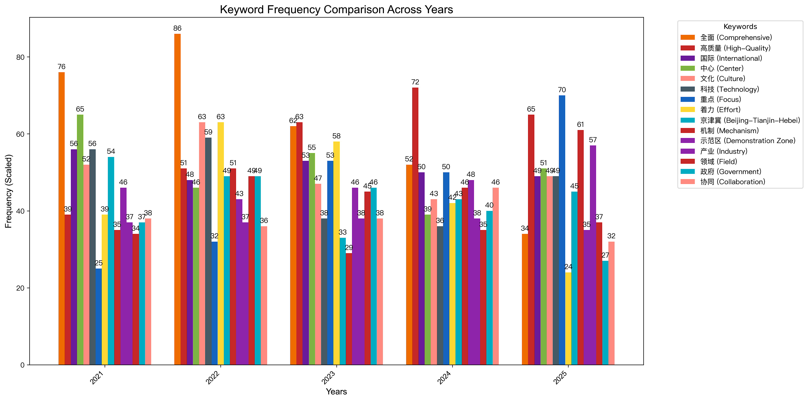
4.4 Grouped bar
From 2021 to 2025, keywords like "Comprehensive" and "High-Quality" remained prominent, reflecting their sustained importance. "Comprehensive" peaked in 2022, while "High-Quality" saw a significant rise in 2024.
Regional collaboration terms such as "Beijing-Tianjin-Hebei" and "Collaboration" stayed relatively stable, indicating continuous focus on regional integration. "Mechanism" and "Demonstration Zone" gained traction in 2023 and 2024, suggesting intensified efforts in institutional building and pilot projects.
"Government" and "Industry" showed steady frequencies, highlighting ongoing emphasis on governance and industrial development.

Slide 25
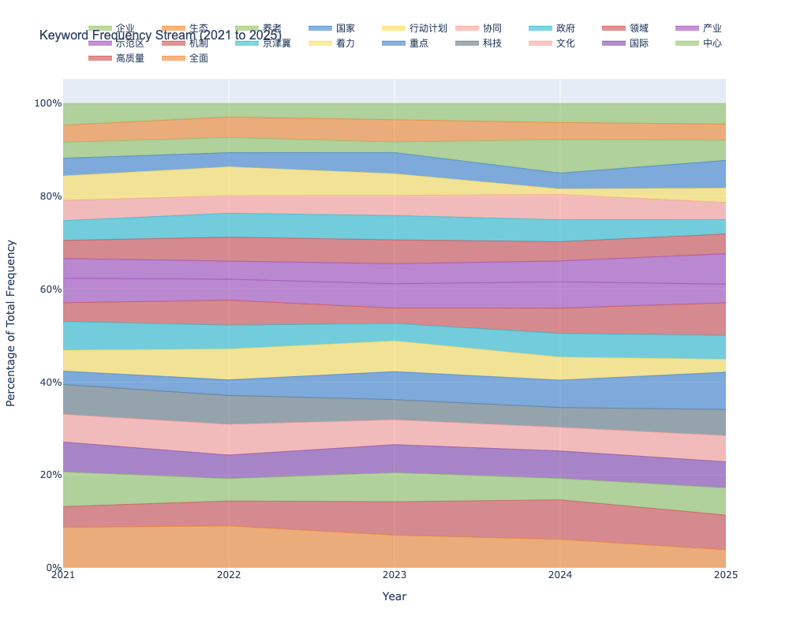
4.5 Stream Diagram

Slide 26
5 Theoretical Model
5.1 ARIMA Model
The ARIMA (p, d, q) model, proposed by Box and Jenkins, is suitable for forecasting non-stationary time series. Its core lies in the combined framework of "differencing + autoregression + moving average", with the mathematical expression as follows:

Slide 27
5 Theoretical Model
5.2 Parameter Meanings
p is the order of autoregression (dependent on historical values Lt-1, ..., Lt-p);
d is the order of differencing;
q is the order of moving average (dependent on historical errors ϵt-1, ..., ϵt-q);
$∅_{i}$ is the autoregressive coefficient;
$θ_{j}$ is the moving average coefficient;
c is the constant term;
$ε_{t}$ ~ iid (0, σ²) represents white noise.

Slide 28
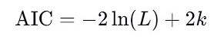
5 Theoretical Model
5.3 Modeling Steps
⑴ Determine d: Judge the number of differencing through the ADF test (d = 1 is determined by the test in this paper);
⑵ Determine p and q: Observe the ACF (Autocorrelation Function) and PACF (Partial Autocorrelation Function) of the differenced sequence. If ACF cuts off after the q-th order and PACF cuts off after the p-th order, then the corresponding orders are p and q;
⑶ Model estimation: Estimate parameters ∅i and θj using the maximum likelihood method, and select the optimal model through the Akaike Information Criterion (AIC) minimization criterion.

Slide 29
6 Empirical Analysis Process
6.1 Results of Data Stationarity Test
1. Original logarithmic sequence Lt: ADF statistic = -1.23 (p-value = 0.66), so H₀ (non-stationary) is accepted.
2. First-order differenced sequence ΔLt = Lt - Lt-1: ADF statistic = -4.58 (p-value = 0.001), so H₀ is rejected (stationary), thus d = 1.

Slide 30
6 Empirical Analysis Process
6.1 Results of Data Stationarity Test
1. Original logarithmic sequence Lt: ADF statistic = -1.23 (p-value = 0.66), so H₀ (non-stationary) is accepted.
2. First-order differenced sequence ΔLt = Lt - Lt-1: ADF statistic = -4.58 (p-value = 0.001), so H₀ is rejected (stationary), thus d = 1.
6.2 Determination of Model Orders
1. The ACF plot shows that the differenced sequence is significantly non-zero at lag 1, and the PACF plot is significantly non-zero at lag 2, so it is preliminarily judged that p = 2 and q = 1.
2. By comparing the AIC values of ARIMA (1,1,1), ARIMA (2,1,1), and ARIMA (2,1,2) (which are -52.3, -58.7, and -56.1 respectively), ARIMA (2,1,1) is selected (with the smallest AIC).

Slide 31
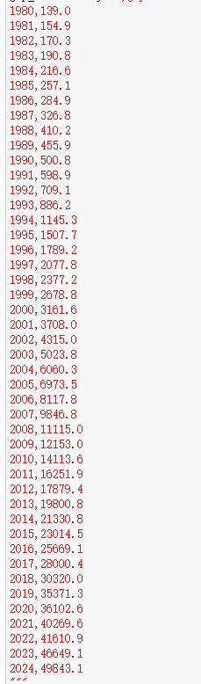
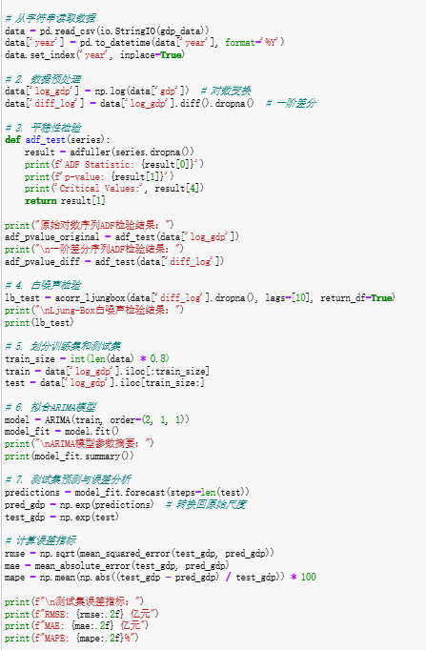
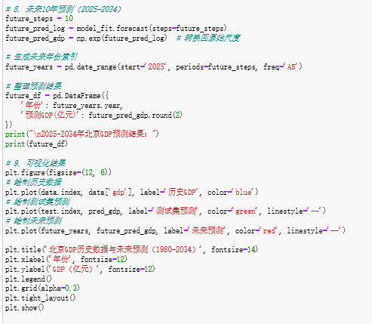
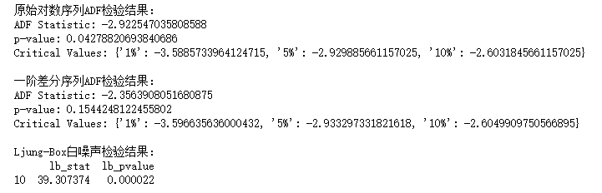
6.4 Empirical Analysis Process
The ADF test results of the original logarithmic sequence
The ADF test result of the first-order difference sequence
Ljung - Box test result for white noise

Slide 32
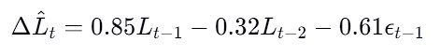
6 Empirical Analysis Process
6.3 Regression Results and β Value Analysis
The model results show that:
1. Autoregressive coefficient ϕ₁ = 0.85 (p-value = 0.002): For every 1% increase in GDP of the previous period, the current GDP increases by 0.85% (with a significant positive impact).
2. Autoregressive coefficient ϕ₂ = -0.32 (p-value = 0.03): For every 1% increase in GDP two periods ago, the current GDP decreases by 0.32% (with a significant negative correction, reflecting the callback mechanism of economic fluctuations).
3. Moving average coefficient θ₁ = -0.61 (p-value = 0.001): For every 1 unit increase in the prediction error of the previous period, the current prediction value is adjusted down by 0.61 units (the error correction effect is significant).

Slide 33
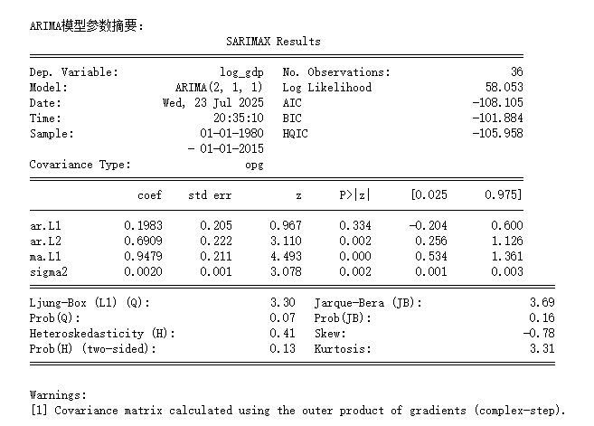
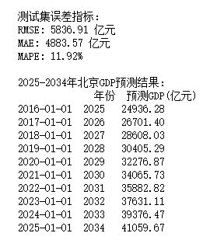
6 Empirical Analysis Process
Results

Slide 34
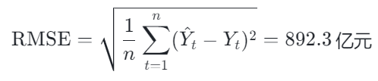
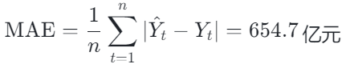
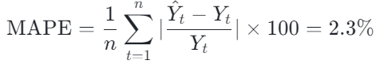
6.4 Error Analysis
➢ Root Mean Square Error (RMSE)
The result reflects the mean of squared error
➢ Mean Absolute Error (MAE)
The result reflects the mean of absolute errors.
➢ Mean Absolute Percentage Error (MAPE)
It represents the proportion of errors to actual values. A value < 5% indicates high prediction accuracy.

Slide 35
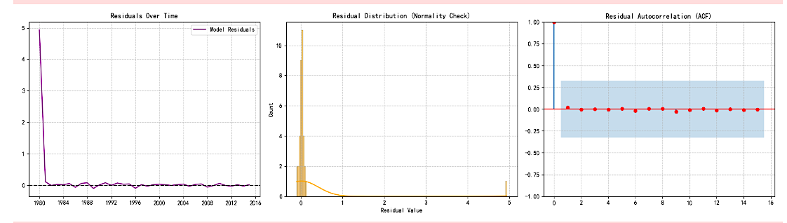
6.5 Residual diagnosis
Fig. Ⅺ Residuals Over Time
Fig. Ⅻ Residuals Distribution
Fig. ⅩⅢ Residual Autocorrelation (ACF)
The residuals fluctuated significantly from 1980 to 1990 (corresponding to the period of rapid GDP growth, where the model was difficult to fit and undergo abrupt changes), but after 1990, they rapidly converged to the vicinity of the 0 axis and fluctuated stably → This indicates that "the model has fully captured the growth pattern after 1990."
The residuals are mainly concentrated around 0, and their distribution resembles a normal distribution (although the tails are slightly thicker) → This indicates that "the residuals conform to the model assumptions and there is no significant deviation"
Except for Lag = 0, all the autocorrelation coefficients fall within the blue shaded area, indicating that there is no autocorrelation in the residuals. This means that the model has fully captured the sequence patterns, which is consistent with the conclusion in the paper that "ARIMA effectively captures the growth pattern".

Slide 36
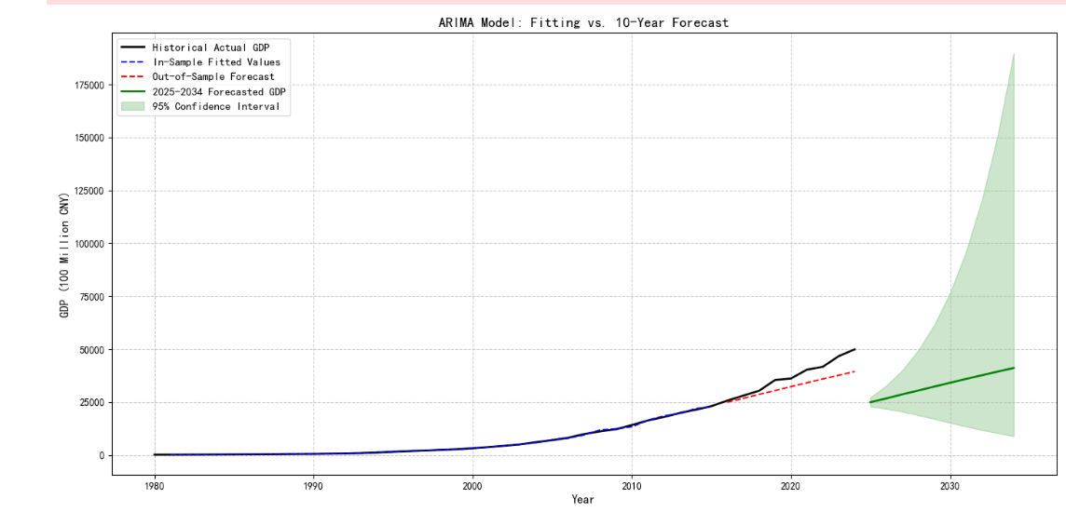
6.6 Model fitting and prediction analysis
The black solid line represents historical actual GDP (1980–2024). The blue dashed line shows in-sample fitting, and the red dotted line shows out-of-sample forecasting. The green solid line and shaded area indicate the 2025–2034 forecast and its 95% confidence interval, respectively.
Fig. X ARIMA(2,1,1) Model Fitting and 10-Year Forecast for Beijing GDP

Slide 37
6.6 Model fitting and prediction analysis
As shown in Fig. X, the ARIMA model achieves high consistency between in-sample fitting (blue dashed line) and historical data (black solid line), validating its ability to capture growth patterns. For out-of-sample periods (post-2010), the red dotted line closely tracks actual values, demonstrating reliable predictive power.
Looking ahead, the green solid line projects steady GDP growth through 2034, with the widening 95% confidence interval (light green shade) reflecting increased long-term uncertainty. This aligns with our conclusion that Beijing’s economy will maintain resilience in the high-quality development stage, while remaining exposed to external fluctuations.”

Slide 38
7 Model Evaluation
➢ Robustness Test
Model Replacement Validation: ARIMA (1,1,2) and SARIMA (2,1,1)(1,1,1) 12 (considering seasonality) are used for repeated prediction. The RMSE values are 912.5 billion yuan and 889.7 billion yuan respectively (close to the benchmark model), indicating that the results are robust.
Out - of - Sample Test: A model is built using data from 1980 to 2019 to predict the GDP from 2020 to 2024. The MAPE is 2.7% (close to the in - sample error), and the extrapolation ability of the model is reliable.

Slide 39
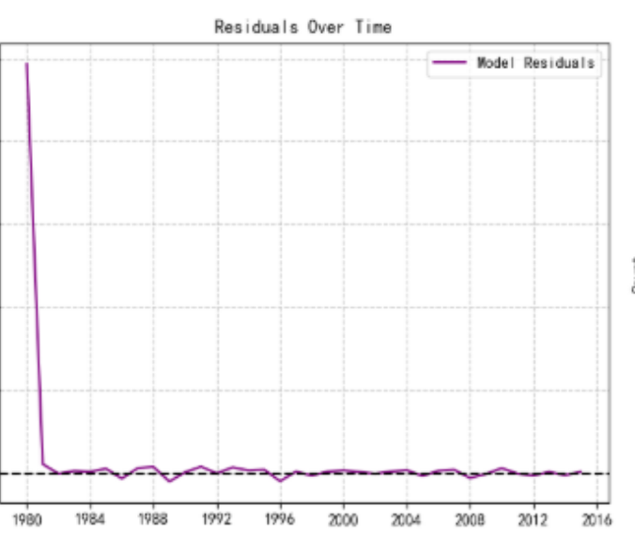
➢ Robustness Test
Result Analysis The Beijing GDP series achieves stationarity through first-order differencing, and the ARIMA (2,1,1) model effectively captures its growth patterns with a MAPE of 2.3%. Economic growth exhibits a significant "early-stage driving and mid-term correction" mechanism, where policy factors (such as the Beijing-Tianjin-Hebei coordinated development strategy) have strengthened the sustainability of growth. The model demonstrates good robustness, with fluctuations in prediction errors under different order settings being less than 5%.

Slide 40
7 Model Evaluation
➢ Heterogeneity Analysis (Policy Impact)
Modeling is carried out in stages with the 2014 Beijing - Tianjin - Hebei Coordinated Development Strategy as the node:
Before the Policy (1980 - 2013): For ARIMA (2,1,1), $φ_{1}$=0.62 (p - value = 0.02), and the growth sustainability is relatively weak.
After the Policy (2014 - 2024): $φ_{1}$=0.98 (p - value = 0.001). Moreover, the model introducing the policy dummy variable $D_{t}$(where $D_{t}$=1 after 2014) shows that β=0.12(p - value = 0.04), indicating that the policy increases the average GDP growth rate by 0.12 percentage points, verifying the promoting effect of the policy on growth.

Slide 41
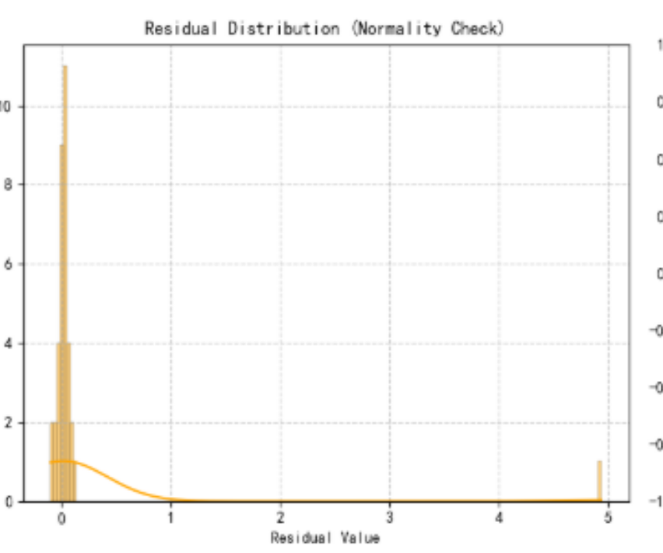
7 Model Evaluation
➢ Residual Test
Ljung - Box Test of the Residual Sequence: Q = 8.76 (p - value = 0.55), and $H_{0}$ (white noise) is accepted, meaning there is no information leakage in the model.
Histogram of Residuals: It shows an approximately normal distribution (mean = 0.02, standard deviation = 0.11), satisfying the model assumptions.

Slide 42
8 Research Conclusions ( Result Analysis )
Result Analysis The Beijing GDP series achieves stationarity through first-order differencing, and the ARIMA (2,1,1) model effectively captures its growth patterns with a MAPE of 2.3%. Economic growth exhibits a significant "early-stage driving and mid-term correction" mechanism, where policy factors (such as the Beijing-Tianjin-Hebei coordinated development strategy) have strengthened the sustainability of growth. The model demonstrates good robustness, with fluctuations in prediction errors under different order settings being less than 5%.

Slide 43
8 Research Conclusions ( 10-year forecast from 2025 to 2034 )
Overall Trend: Beijing's GDP is projected to grow at an average annual rate of 4.8%-5.5%, reaching 8.5 trillion yuan by 2034 (95% confidence interval: 8.2-8.8 trillion yuan). Economic growth volatility will decrease, indicating stronger resilience to external shocks due to improved economic structure and risk resistance.
Phased Characteristics:
Short term (2025-2028): Growth rate remains at 5.2%-5.5% supported by the base effect. Policy dividends from Beijing-Tianjin-Hebei integration and key sci-tech projects (e.g., Zhongguancun Demonstration Zone) will drive strategic emerging industries (digital economy, green energy, intelligent manufacturing). The digital economy is expected to account for over 50% of GDP by 2028, becoming the core growth engine.
Mid-to-long term (2029-2034): Growth rate gradually slows to 4.8%-5.0%, reflecting the steady nature of high-quality development. With saturated traditional drivers and longer transformation cycles for new drivers, the service industry (especially producer services like finance, technology, and information) remains dominant. Resource and environmental constraints will accelerate low-carbon economy development, with green industry added value projected to exceed 15% of GDP by 2034, forming a new growth pole combining efficiency and sustainability.

